Slide 1
GROUP 101
Team :
Naved Sayyad
Shubham Katewad
Srirupa
Preethi Mattewada

Slide 2
Problem Statement:
In traditional offline theatre ticket booking, patrons face challenges in reserving tickets efficiently due to the absence of a centralized system. Customers often wait in long lines, only to find limited seat availability or confusion regarding show timings, pricing, and seat locations. Theatre staff, on the other hand, struggle with managing ticket inventory, preventing duplicate bookings, and tracking cash transactions accurately.
Solution:
To resolve the above issue, we will implement an online ticketing system that allows customers to purchase and access their tickets through a mobile application or print them at home, providing a convenient and seamless experience.

Slide 3
Functional Requirements:
User Registration and Authentication: Users should be able to sign up and login securely.
Movie Listings: Display a comprehensive list of movies with details like title, genre, cast, and showtimes.
Search and Filters: Enable users to search for movies by title, genre, or date, and apply filters.
Seat Selection: Allow users to choose their preferred seats from an interactive seating chart.
Payment Gateway Integration: Securely process payments using various methods like credit/debit card, digital wallets, etc.
Ticket Confirmation: Generate and send e-tickets to users via email or SMS.
User Profile Management: Let users update their personal information and view their booking history.
Reviews and Ratings: Allow users to rate and review movies.
Notifications: Send reminders and updates about bookings and upcoming movies.

Slide 4
User Stories
As a registered user,
I want to log in to the online movie website
so that I can access my account and watch movies
As a user,
I want to browse movie listings
so that I can find a movie to watch
As a user,
I want to search for and filter movies
so that I can quickly find something specific to watch

Slide 5
As a user,
I want to select my seat for a movie showing
so that I can choose where I will sit
As a user,
I want to securely pay for my movie tickets online
so that I can complete my booking without any hassle
As a user,
I want to receive a ticket confirmation
so that I know my booking is secure and have the necessary details for my movie

Slide 6
As a user,
I want to manage my profile
so that I can keep my information up-to-date and personalize my experience
As a user,
I want to leave reviews and ratings for movies
so that I can share my opinions and help other users make informed choices
As a user,
I want to receive notifications
so that I can stay updated about my account and movie bookings

Slide 7
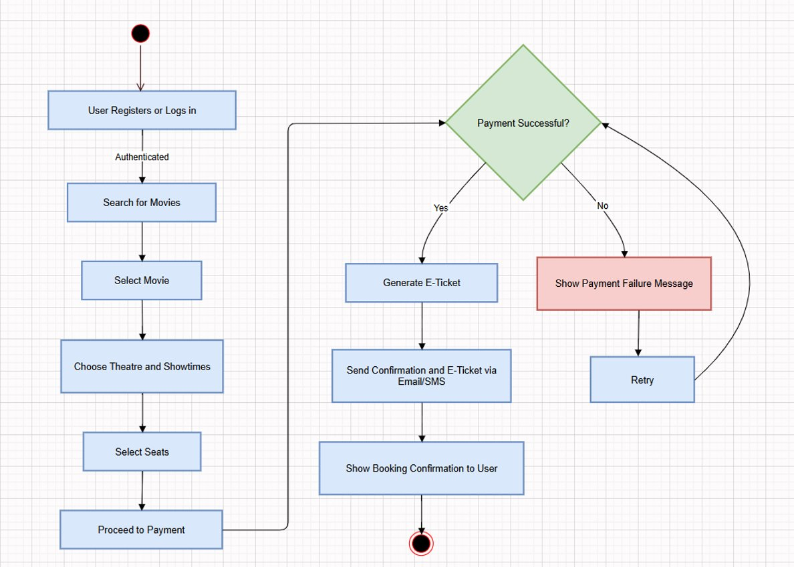
Process Diagram

Slide 8
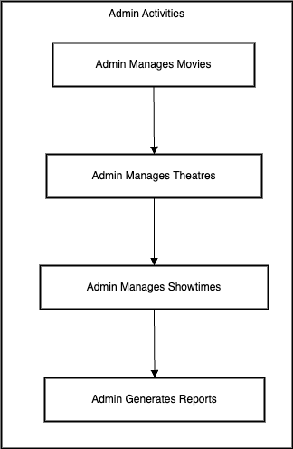
Admin Flow

Slide 9


Slide 10
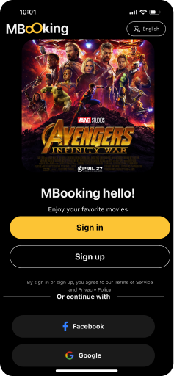
User Authentication

Slide 11
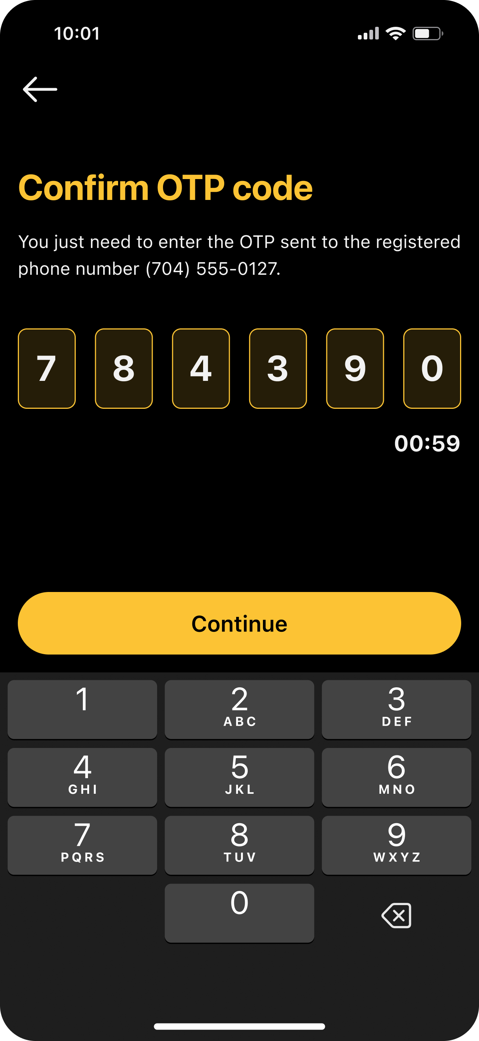
OTP Verification

Slide 12
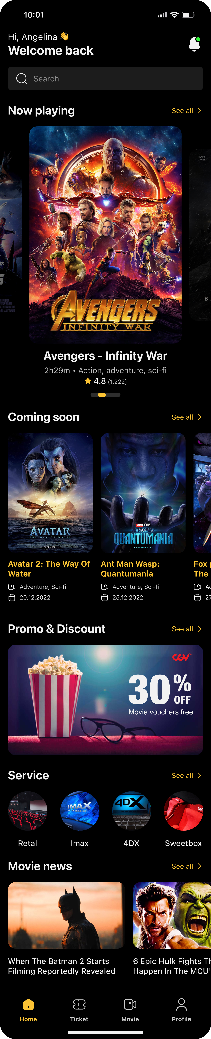
Home Page

Slide 13
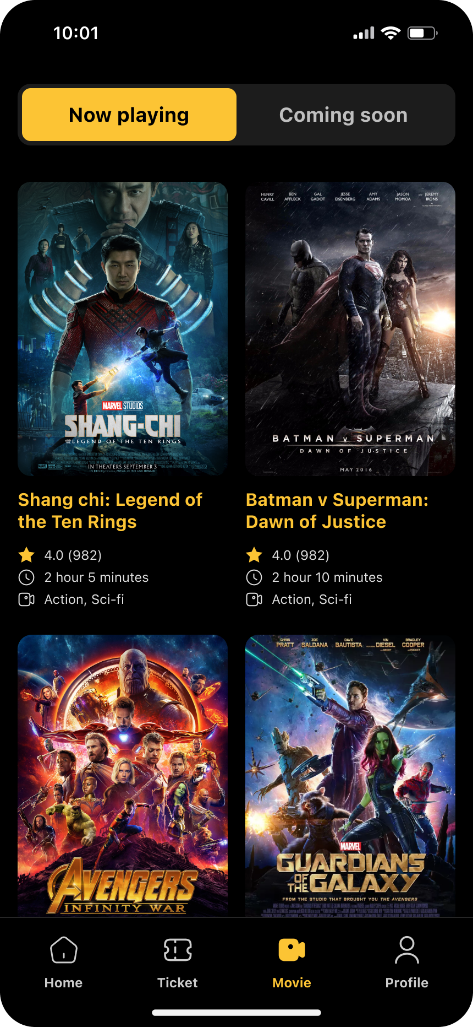
Now Playing

Slide 14
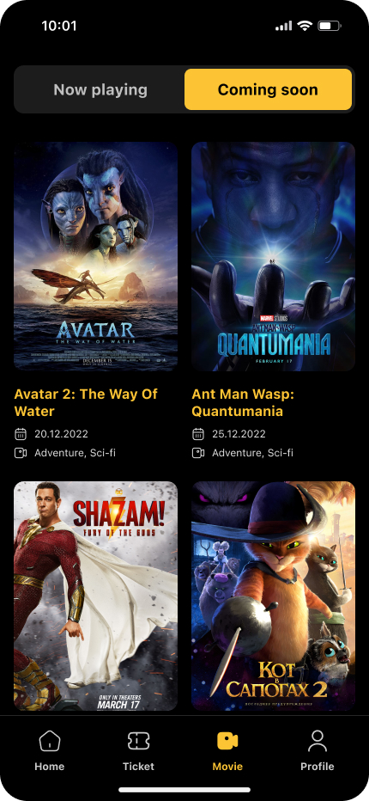
Coming Soon

Slide 15
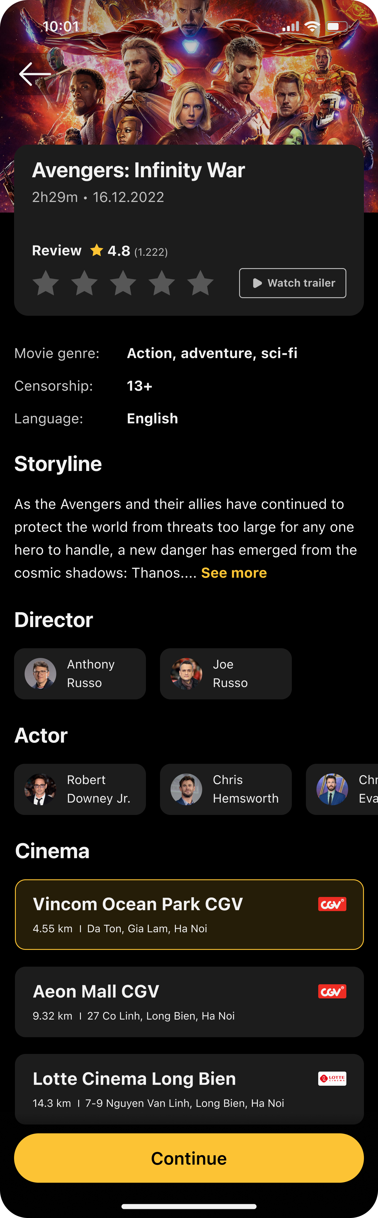
Selected Movie and Theatre

Slide 16
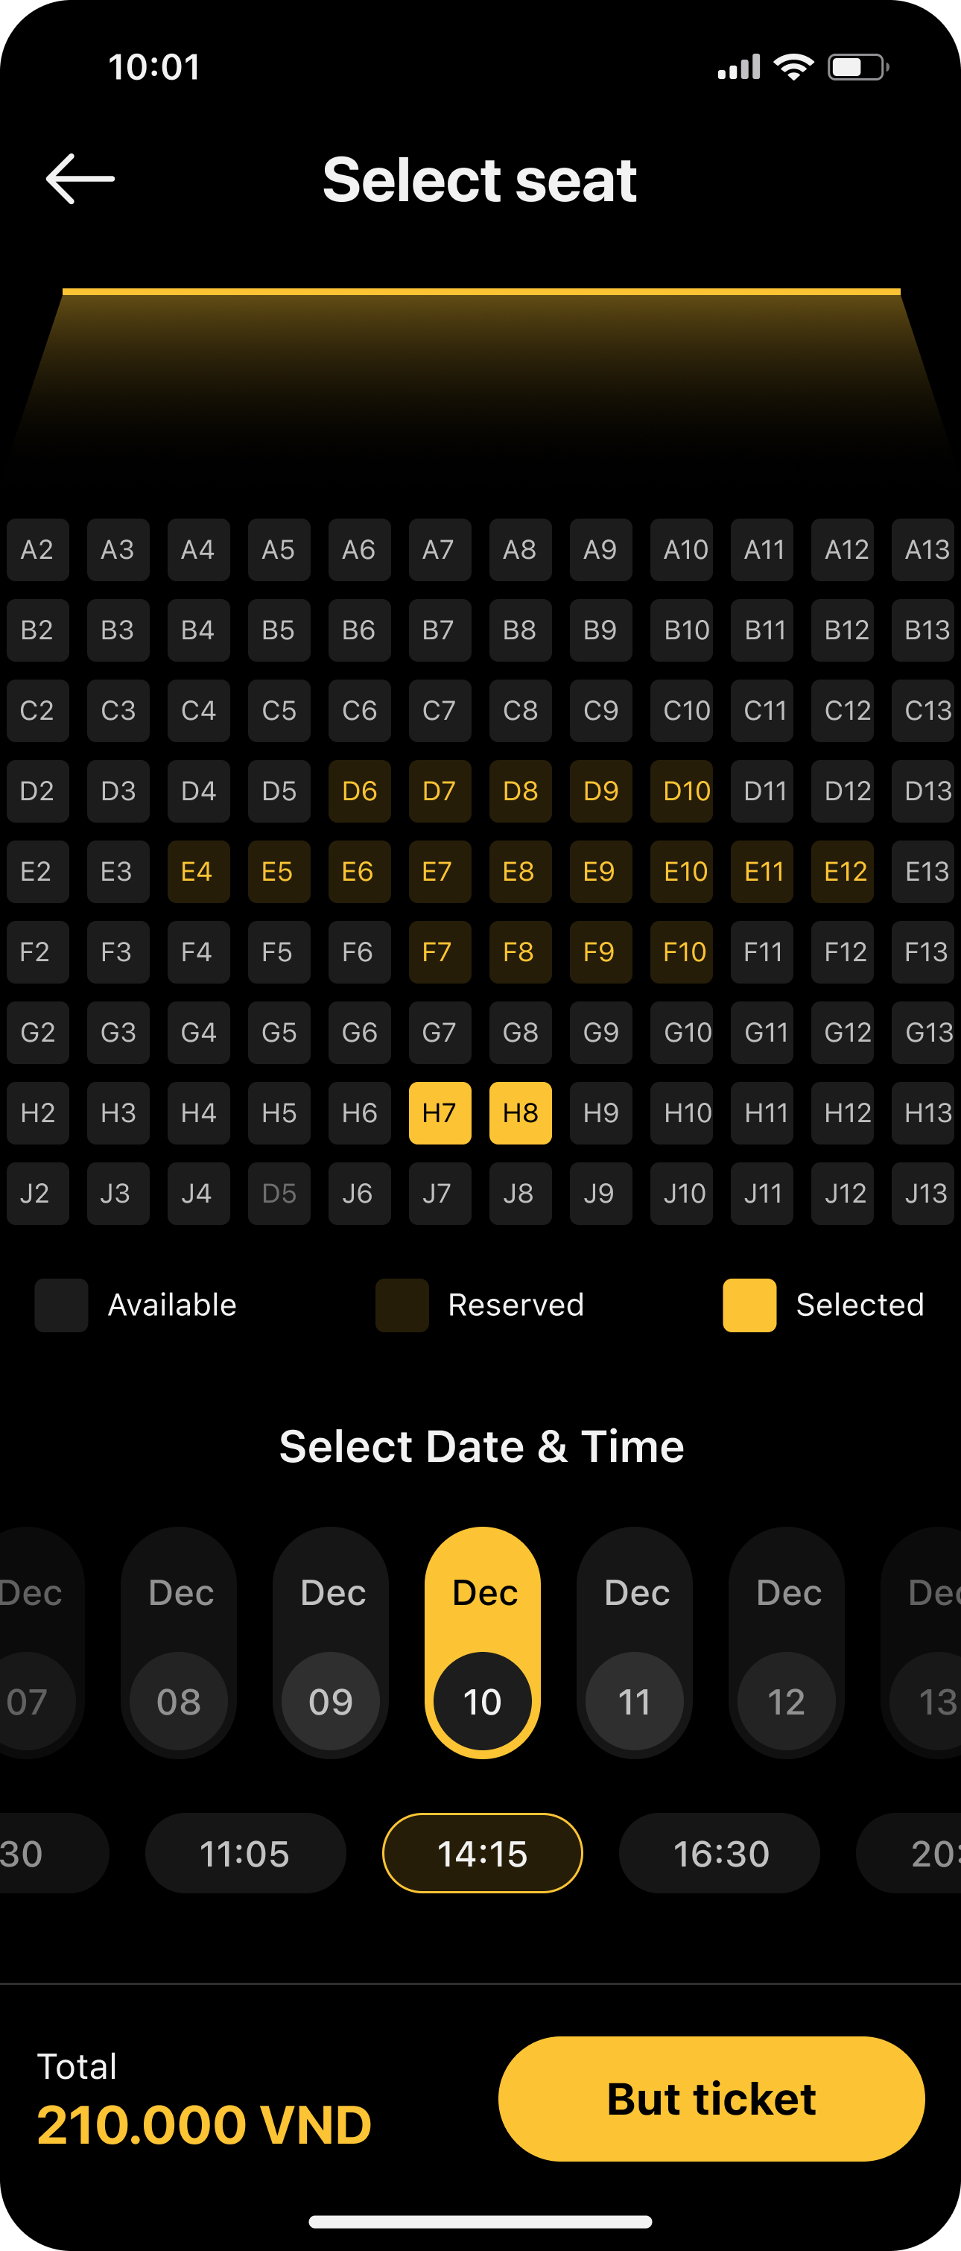
Select Seats

Slide 17
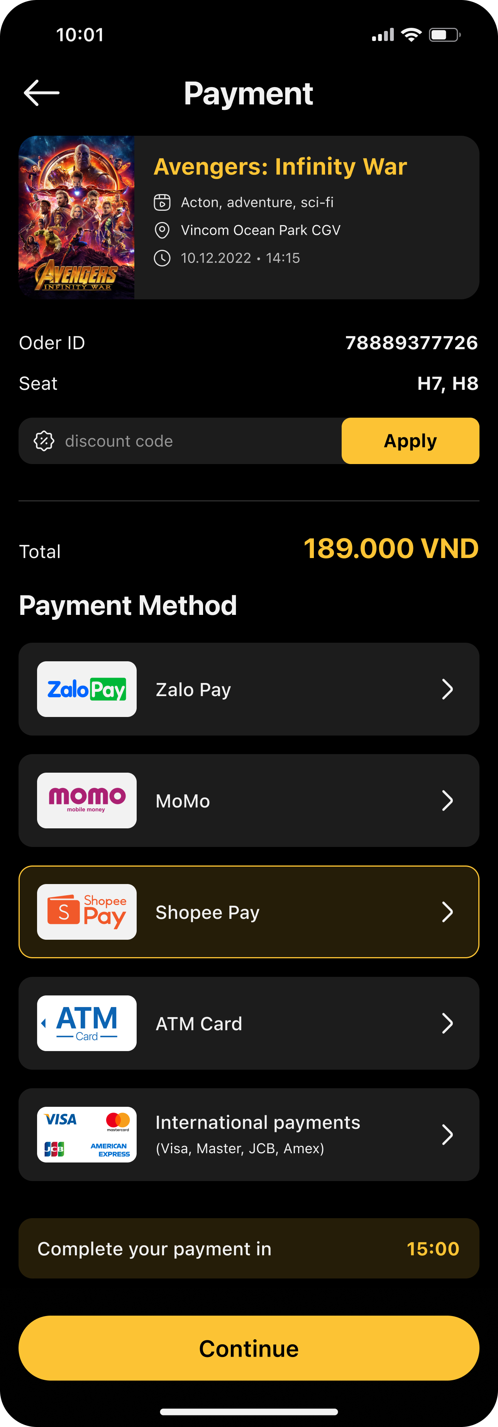
Payment

Slide 18
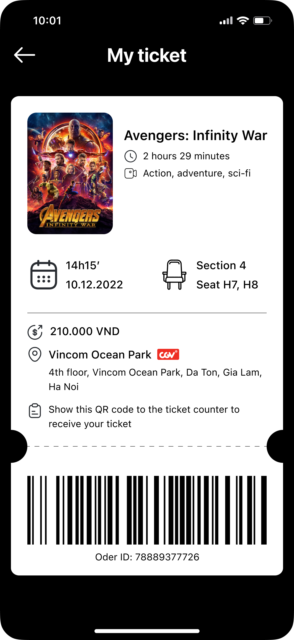
Generate Ticket

Slide 19
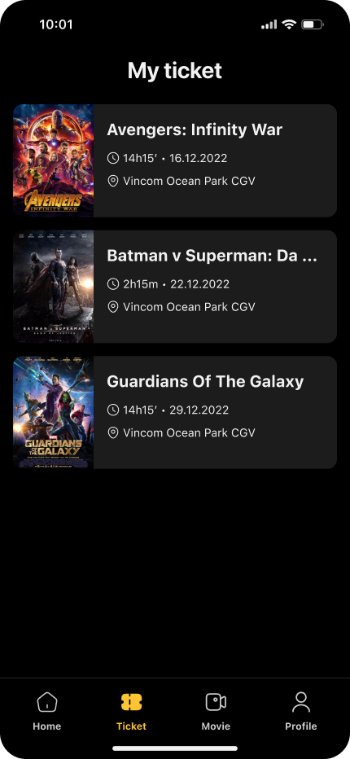
All tickets

Slide 20
Non Functional Requirements
1) Performance: The system should handle at least 7000 simultaneous users during peak times with a response time of 2 seconds.
2) Scalability: The system structure should support future scaling like adding new servers because of increased traffic and users.
3) Reliability: The system should have 99.99% uptime even in peak weekends and festival timings.
4) Security: All sensitive user data, including payment information, should be encrypted in transit and at rest.
5) Design: The Platform should have a user-friendly interface for better customer experience.
6) Compatibility: The Platform should be compatible with different browsers and applications with updated versions.
7) Compliance: The Platform should ensure compliance with GDPR for customers data protection and should manage licenses for any third-party services or libraries used in the development.

Slide 21
Thank You!!

